Slide 1

KALERWE
S.D.A Hymnal
3 ~ Verses
71.
Gwe Omukristayo Tunula.…
~
Watch For the Time is Short…

Slide 2

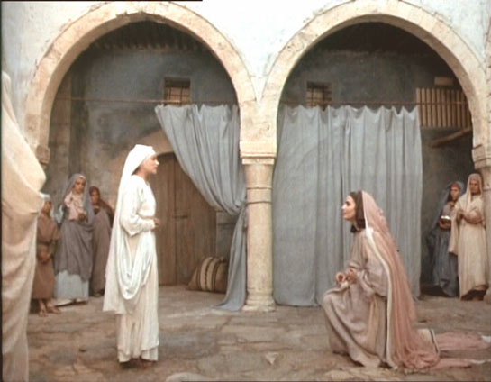
1 of 3 verses
Gwe Omukri-sta-yo
Tunula kaka-no,
Laba esi-ga-dde,
Kaseera buseera.
Tunula, Yes(u) –ajja-,
(O)mubiri muna-fu,
(O)mulabe wa- maanyi,
Tunula, saba-nga.

Slide 3
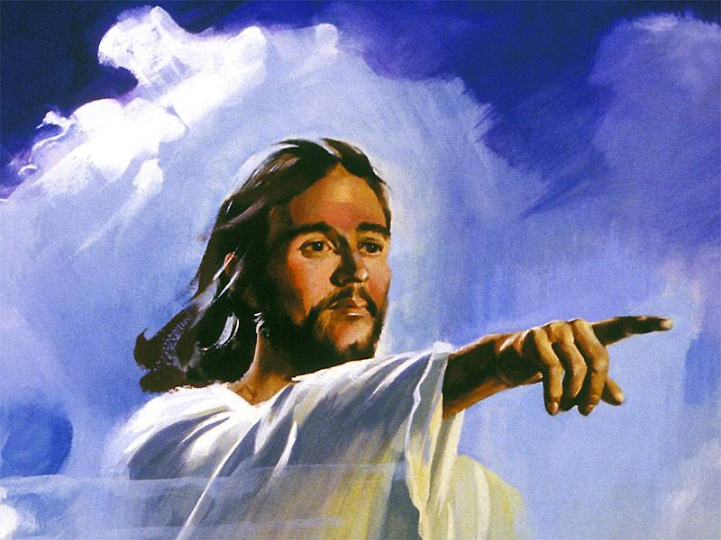
1 of 3 verses
Chorus:
Omu-krista-yo
tu-nu-la,
E-kiro n’emi-sana,
tunulanga,
Tu-nu-la, Saba.

Slide 4
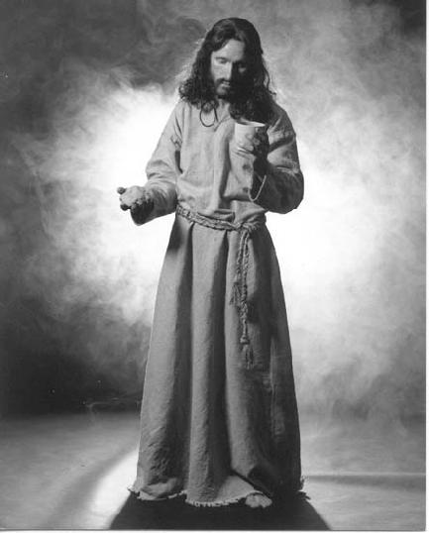
2 of 3 verses
Leka kubo-ngoo-ta,
So tobusabu-sa
Waliw(o) eki-ra-bo,
Kye wasuubizibwa.
Kwe kuwummuli-ra Eyo
Yesu gy’a-li,
Eyakufii-ri-ra Tunula,
sabanga.

Slide 5
2 of 3 verses
Chorus:
Omu-krista-yo
tu-nu-la,
E-kiro n’emi-sana,
tunulanga,
Tu-nu-la, Saba.

Slide 6
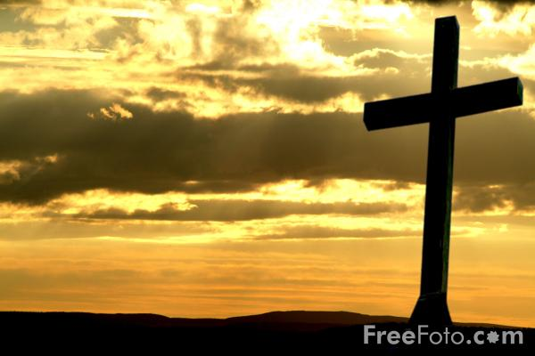
3 of 3 verses
Bw’olumbwa o-mu-bi
Yesu ye aku-wa,
Eby’okulwa-nyi-sa
Gw’obanga wesiga.
Lindirira Ye-su,-
Ye gwe musana- gwo.
Kano ke ka-see-ra
Tunula, saba-nga.

Slide 7
3 of 3 verses
Chorus:
Omu-krista-yo
tu-nu-la,
E-kiro n’emi-sana,
tunulanga,
Tu-nu-la, Saba.

